Slide 1

1
MULTI PATH LOAD BALANCING IN SDN NETWORKS
Guided by:
Presented by:
Diya Nair
Gawtham Choodan A V Nikhitha G
Nissi Mary Joseph
SCT22EC056 SCT22EC062 SCT22EC094 SCT22EC097
Prof. Soumya CS Department SCTCE

Slide 2
CONTENTS
2
Introduction
Problem Statement
Objectives
Proposed Solution
Literature Review
Comparison
Sdn And Ryu Overview
Methodology
Algorithm Design
Network Architecture & Topology
Simulation Environment
Result And Analysis
Advantages And Applications
Conclusion
References

Slide 3

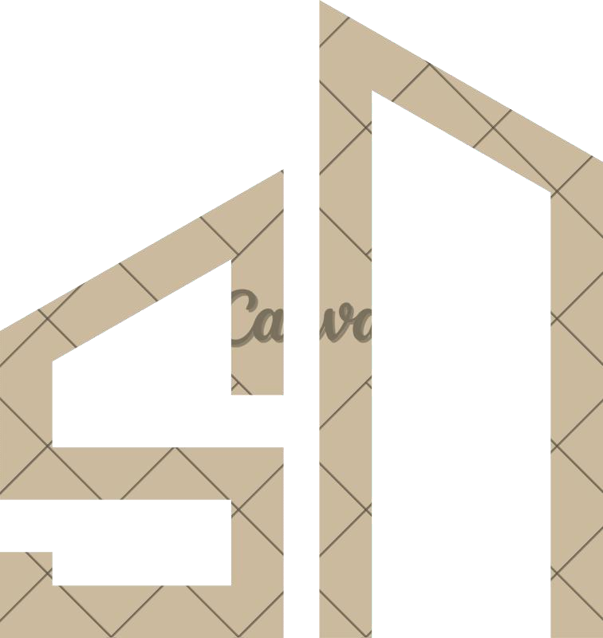
INTRODUCTION
3
Multipath Routing finds multiple paths to send data in a network.
It helps distribute traffic across these paths, which is called load-balancing.
This makes the network more efficient and reliable.
With Software-Defined Networking (SDN) and the OpenFlow protocol, multipath routing is easier and more flexible.
Since OpenFlow version 1.1, a feature called Group Tables allows applying multiple actions to one data flow — enabling multipath routing.

Slide 4
PROBLEM STATEMENT
4
"In modern networks, single-path routing often leads to congestion, underutilization of network resources, and increased latency. Traditional load balancing methods fail to efficiently utilize multiple available paths simultaneously. This project aims to implement a multipath load balancing mechanism using the Ryu SDN controller to dynamically distribute traffic across multiple optimal paths, thereby improving network throughput, reducing
latency, and enhancing overall reliability."

Slide 5
OBJECTIVES
5
Implement Multipath Routing:
To develop a method for finding and using multiple paths between source and destination nodes in an SDN environment.
Achieve Load Balancing:
To distribute network traffic evenly across available paths, reducing congestion and improving performance.
Use Ryu SDN Controller:
To design and implement the solution using the Ryu controller, taking advantage of its programmable and Python-based architecture.
Utilize OpenFlow Features:
To use OpenFlow (like Group Tables) for applying multipath routing and controlling traffic flow dynamically.
Evaluate Network Efficiency:
To test and measure improvements in network performance such as reduced delay, better bandwidth usage, and less packet loss.

Slide 6
6
PROPOSED SOLUTION
Network Topology Design:
Design a custom network topology in Mininet with multiple paths between source and destination nodes.
Ryu Controller Programming:
Develop a custom Ryu program to detect all possible paths using DFS algorithm and calculate optimal paths.
Path Selection & Load Distribution:
Use different logics to distribute traffic across multiple paths for load balancing.
Utilize OpenFlow Features:
To use OpenFlow (like Group Tables) for applying multipath routing and controlling traffic flow
dynamically
Performance Monitoring & Testing:
Simulate traffic using tools like iperf and evaluate metrics like throughput, delay, and packet loss to verify improved performance.

Slide 7
LITERATURE REVIEW
7
SL NO | Citation | Concept / Contribution | Relevance & Learnings | Identified Gap
1 | A. Di Maio, M. R. Palattella, and T. Engel, “Multi-Flow Congestion-Aware Routing in Software-Defined Vehicular Networks,” | Proposes MFCAR, a centralized congestion-aware routing algorithm for 5G SDVNs, dynamically switching V2I2V to V2V paths using graph-based congestion estimation. | Shows centralized SDN can efficiently manage multi-flow vehicular traffic. Avoids channel probing via estimation. | Limited to vehicular networks. Our work generalizes to IP traffic & mixed SDN topologies.
2 | D. Goteti and I. Rasheed, “Multipath Routing Algorithm to Find Optimal Path in SDN with POX Controller,” | Introduces multipath routing using POX controller to identify optimal and alternative paths to reduce congestion. | Confirms that topology design impacts SDN performance. POX enables effective congestion control. | Tested only on static topologies. Our study uses Ryu and supports dynamic environments.
2

Slide 8
LITERATURE REVIEW
8
SL NO | Citation | Concept / Contribution | Relevance & Learnings | Identified Gap
3 | M. Shafiee and J. Ghaderi, “A Simple Congestion-Aware Algorithm for Load Balancing in Datacenter Networks,” | Proposes a myopic, congestion- aware algorithm for unsplittable flows in datacenter networks with near-optimal load balance. | Simple routing with local cost minimization can achieve global load balancing. | Datacenter-specific model. We apply similar principles to general-purpose SDN with topology changes.
4 | L. L. Prasanth and E. Uma, “A Computationally Intelligent Framework for Traffic Engineering and Congestion Management in Software-Defined Network (SDN),” | Presents AI-based SDN with mGRNN for prediction and CA- HPO for congestion-aware routing. Improved throughput and delay vs. GA/PSO. | Combines deep learning + metaheuristics for proactive traffic control. | High computational overhead. Our approach uses lightweight multipath routing for real-time adaptation.
5 | J. Chen, W. Xiao, H. Zhang, J. Zuo, and X. Li, “Dynamic Routing Optimization in Software-Defined Networking Based on a Metaheuristic ” | Proposes AVRO, a metaheuristic routing optimizer using link betweenness and adaptive stages. Outperforms DRL & traditional methods. | Metaheuristics offer better scalability and load balance than DRL under dynamic loads. | Evaluated only in simulation. Our work integrates with real SDN controllers (e.g., Ryu).

Slide 9
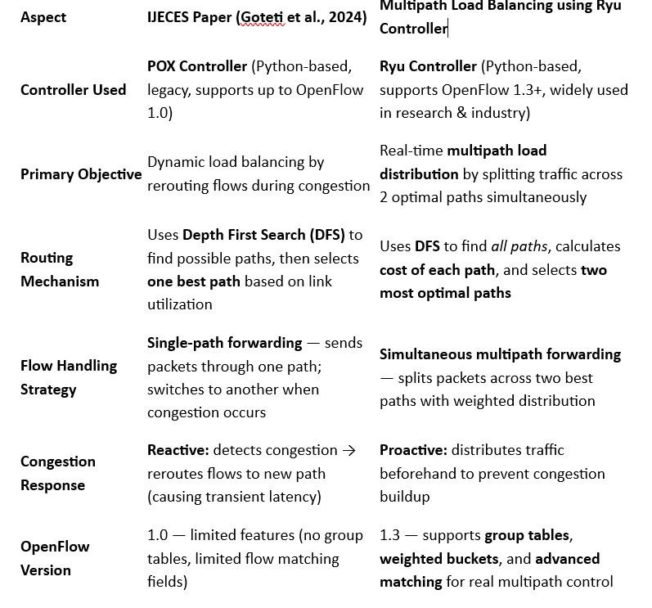
COMPARISON
9

Slide 10
SDN AND RYU OVERVIEW
10
Software Defined Networking (SDN):
Separates Control Plane and Data Plane.
Provides a centralized view of the network.
Enables flexible reconfiguration and programmability.
Ryu Controller:
Python-based open-source SDN controller.
Uses OpenFlow 1.3 to manage network switches.
Ideal for rapid network prototyping and algorithm testing

Slide 11
METHODOLOGY 11
Design Topology in Mininet (multiple paths between source and destination).
Start Ryu Controller and load the program for path discovery.
Collect link statistics using SFlow.
Calculate link costs based on available bandwidth.
Select path with minimum cost for data transmission.
Install group entries via OpenFlow group tables.
Generate traffic using Iperf to measure performance metrics.

Slide 12
ALGORITHM DESIGN(DFS+BANDWIDTH COST) 12
Step 1: DFS identifies all possible paths between source and destination.
Step 2: Each link’s bandwidth and usage are monitored using SFlow.
Step 3: Path Cost = Σ (Reference Bandwidth / Available Bandwidth).
Step 4: Controller selects path with lowest cost (least congested).
Step 5: Flow rules installed dynamically using Ryu’s OpenFlow Protocol.
Step 6: Real-time adjustments performed when traffic load changes.

Slide 13
NETWORK ARCHITECTURE AND WORK FLOW 13
.
System Overview:
The proposed system is built on a Software Defined Networking (SDN) framework using the
Ryu Controller for centralized management.
SDN separates the Control Plane from the Data Plane , enabling real-time traffic optimization.
The design has four layers:
Application Layer: Multipath load-balancing logic.
Control Layer: Ryu installs flow rules via OpenFlow 1.3.
Data Layer: Open vSwitch (OVS) switches emulate forwarding elements.
Host Layer: End devices generating or receiving traffic.

Slide 14
NETWORK ARCHITECTURE AND WORK FLOW
14
.
Workflow:
Controller discovers paths using DFS.
SFlow monitors real-time bandwidth.
Least-congested path selected using bandwidth-based cost.
OpenFlow group tables distribute load; rerouting occurs dynamically during congestion.

Slide 15
SIMULATION ENVIRONMENT
15
Parameter | Configuration
Emulator | Mininet
Controller | Ryu (Python-based)
Communication Protocol | OpenFlow 1.3
Monitoring | SFlow
Traffic Tool | Iperf

Slide 16
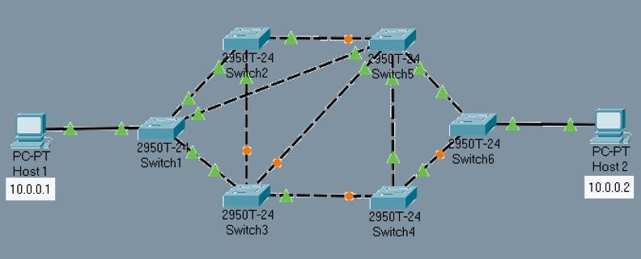
RESULT AND ANALYSIS
16
NETWORK TOPOLOGY
Overview:
The topology consists of 6 interconnected switches (Switch1–Switch6) and 2 hosts (Host1 and Host2).
Multiple redundant paths exist between the source (10.0.0.1) and destination (10.0.0.2).
Implemented using Software-Defined Networking (SDN) with the RYU controller for centralized network control.

Slide 17
Result Analysis in Mininet-Ryu Setup
17
Test/Action | Details | Observed Data & Values | Conclusions
Topology Setup | Network with 2 hosts (h1,h2), 6 switches (s1-s6) connected with multiple paths | Total switches: 6 Links: Multiple cross- links forming redundant routes | Supports multipath routing and load balancing
Ping Test (pingall) | Verifies basic connectivity and reliability between all nodes | 0% packet loss (all hosts reachable) RTT avg ~0.1 ms | Network stable, no packet loss under multipath topology
Flow Table Inspection | Check flows on key switches (s1,s3,s5) | Flows use group tables Distributed IP and ARP flows on multiple paths | Multipath load balancing implemented using group tables
Port Statistics (s1, s3, s5) | Traffic counts per port to confirm load distribution | Packet counts range ~20–315 per port Diverse rx/tx values across ports | Traffic distributed dynamically over multiple links
iperf Bandwidth Tests | TCP bandwidth measurement betweenh1andh2 | Throughput: 16.8–25.2 Gbits/sec | High throughput achieved, surpassing typical single path capacity
Link Failure Simulation | Disabled links1-s3and tested connectivity & throughput | No packet loss during failure iperf bandwidth sustained | Controller dynamically reroutes traffic without disruption
Recovery & Stability | Link restored and network tested again | Normal flow resumed Stable RTT and packet delivery | Fast recovery and resilient multipath network
Costs & Path Calculations | Controller identified multiple paths with associated costs and bucket weights | Example paths between 6 → 1 with costs 2 and 3 Bucket weights used in flow groups | Cost-based path selection balances load, optimizes traffic routes

Slide 18
ADVANTAGES AND APPLICATIONS
18
Advantages:
Efficient bandwidth utilization through adaptive routing.
Real-time load redistribution under congestion.
Lower latency, jitter, and packet loss.
Increased network reliability and throughput.
Scalable and programmable through Ryu Controller.
Applications:
Data Centers: Balancing multi-server traffic.
5G Networks: Low-latency core routing.
IoT Systems: Managing sensor data traffic.
Cloud and Edge Computing: Load sharing between virtualized nodes.

Slide 19
CONCLUSION 19
The proposed project aims to implement Multipath Load Balancing in Software Defined Networking (SDN) using the Ryu controller.
The main objective is to improve network performance by distributing data traffic dynamically across multiple available paths rather than relying on a single path.
The system will use bandwidth-based path selection, where the controller continuously monitors link usage and selects the path with maximum available bandwidth to avoid congestion.
Using Mininet, Ryu controller, and OpenFlow, we plan to simulate and analyze the performance of the proposed mechanism compared to traditional single-path routing.
This approach is expected to achieve better resource utilization, reduced delay, and improved reliability in SDN-based networks.

Slide 20
REFERENCES 20
M. Nkosi and A. Lysko, “Multi-path Load Balancing for SDN Data Plane,” in Proc. of International Conference on Advanced Network Architectures and Protocols, Dec. 2023.
D. Li, H. Liu, and Y. Jin, “MPF-MLBS: A Multi-path Load Balancing Strategy for SDN Networks Based on Multiple Performance Factors,” Journal of Mathematics and Computer Science, vol. 20,
pp. 45–56, 2020.
M. Barakabitze, Z. Sun, I. Mkwawa, and E. Ifeachor, “QoE-Centric SDN-Based Multipath Routing Approach for Multimedia Services over 5G Networks,” IEEE Access, vol. 6, pp. 49537–49555, 2018.
S. Zannettou, M. Sirivianos, and F. Papadopoulos, “Exploiting Path Diversity in Datacenters Using MPTCP-Aware SDN,” in Proc. of IEEE Conference on Network and Service Management (CNSM), 2015, pp. 67–74.
O. Ri, Y. Kim, and Y. Jong, “Hybrid Load Balancing Method with Failover Capability in Server Cluster Using SDN,” arXiv preprint arXiv:2307.05552, 2023.

Slide 21


